Slide 1
CHAPTER 1
FUNCTIONS AND MODELS

Slide 2
CONTENTS
1.1 Four way to represent a function
1.2 Model and Curve Fitting
1.3 New Functions from Old Functions
1.4 Graphing Calculators and Computers
1.5 Exponential Functions
1.6 Inverse Functions and Logarithmic Functions
1.7 Parametric Curves

Slide 3
1.5 EXPONENTIAL FUNCTIONS
1.5.1 Exponential functions
1.5.2 Applications of exponential functions
1.5.3 The number e

Slide 4
1.5.1 Exponential functions
An exponential function is a function of the form
f(x) = a^{x}
where a > 0.
If x = n, a positive interger then
If x = 0, then a^{x} = 1, and if x = –n , where n is a positive integer then

Slide 5
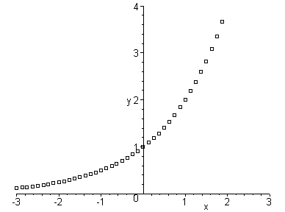
If if x = p / q, where p and q are intergers and q > 0 then
The graph of 2^{x} for x rational

Slide 6
There are holes in the graph. We want to fill in the holes by defining f(x)=2^{x} for x∈R so that f is increasing
For example to define f(a), for we note that :
since f is increasing
Similarly we have, by using better approximation for
The sequence 2^{1.7} , 2^{1.73} , 2^{1.732} , … is said to be increasing,
and the sequence 2^{1.8} , 2^{1.74} , 2^{1.733} , … is decreasing

Slide 7
In 2.6 we will prove that both of these sequences approach the same limit which is real number b
and we define f(a) = b
For example we have the following approximation correct to six decimal places
Similarly we can define 2^{x} for any x irrational and fill the gaps in the above graph

Slide 8
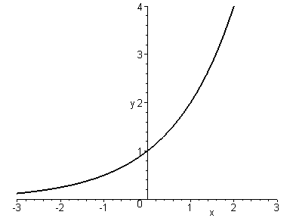
The function f(x) = a^{x}, a > 0 may be defined in a similar manner

Slide 9
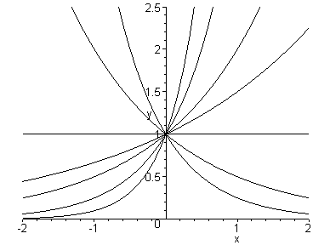
If 0<a<1 a^{x} decreases and approaches 0 for x large
If a >1 a^{x} increases and approaches 0 for –x large
0.25^{x}
10^{x}
4^{x}
2^{x}
0.5^{x}
1.5^{x}
1^{x}

Slide 10
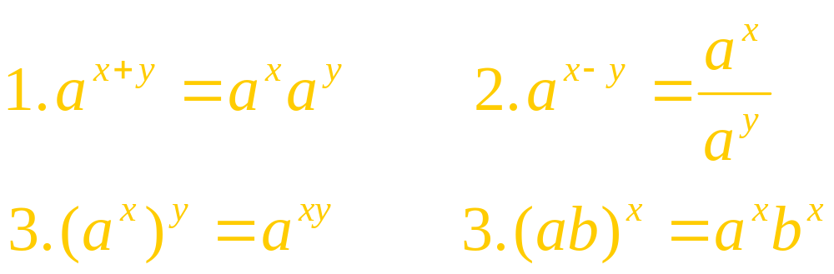
Law of Exponents
If a and b are positive numbers and x and y are real numbers then

Slide 11
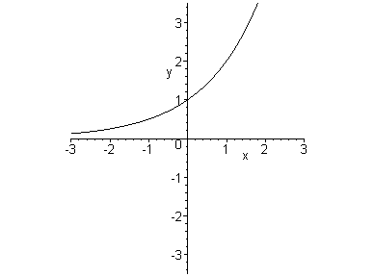
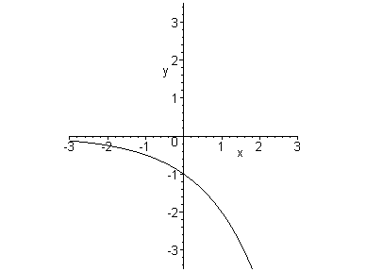
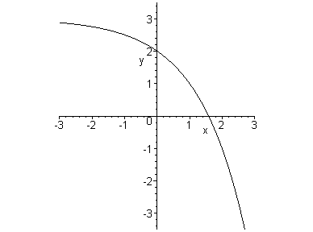
Example: sketch the graph of f(x) = 3 – 2^{x}, and determine domain and range of f
Reflecting about x-axis
shifting upward by 3
y=2^{x}
y=–2^{x}
y=3–2 ^{x}
domain(f) = R, range (f) = ( - ∞, 3)

Slide 12
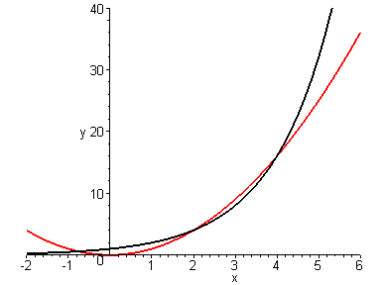
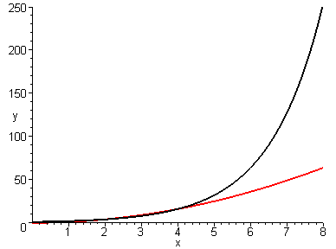
Example: graphing f(x) = 2^{x}, and g(x) = x² and use it to compare the growth of f and g
y=2^{x}
y=2^{x}
y=x²
y=x²
For small x, the graphs intersect 3 times before 2^{x} runs away from x^{2.}

Slide 13
1.5.2 Applications of Exponential functions
Consider a population of bacteria in a homogeneous nutrient medium: the population p(t) doubles every hour. If p(0)=1000 then:
p(1) = 2p(0) = 2 ⋅ 1000
p(2) = 2p(1) = 2² ⋅ 1000
p(3) = 2p(2) = 2³ ⋅ 1000
And in general:
p(t) = 2^{t} ⋅ 1000 = 1000 ⋅ 2^{t}

Slide 14
The graph below shows that the growth of the bacteria population is very rapid

Slide 15
Recall that the human population P(t) is given by the table:
t | P(t) | t | P(t)
1900 | 1650 | 1960 | 3040
1910 | 1750 | 1970 | 3710
1920 | 1860 | 1980 | 4450
1930 | 2070 | 1990 | 5280
1940 | 2300 | 2000 | 6070
1950 | 2560

Slide 16
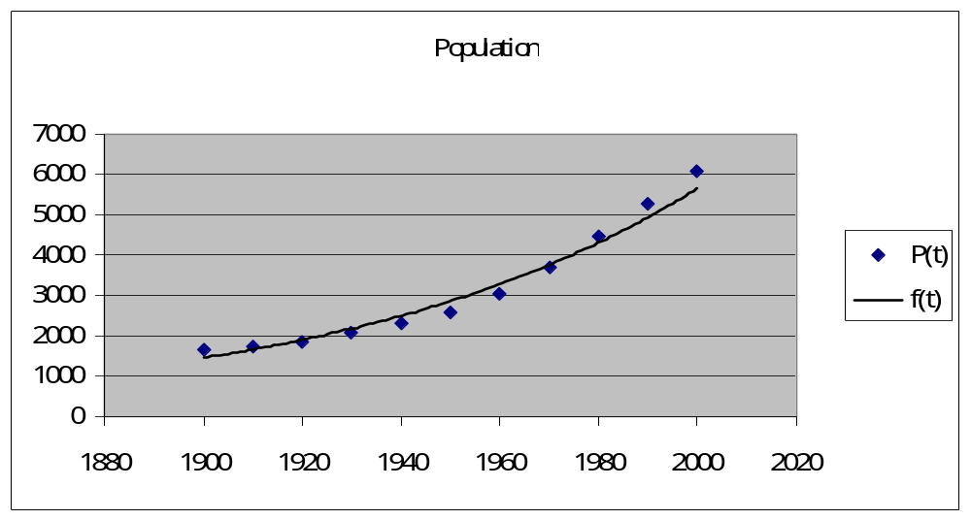
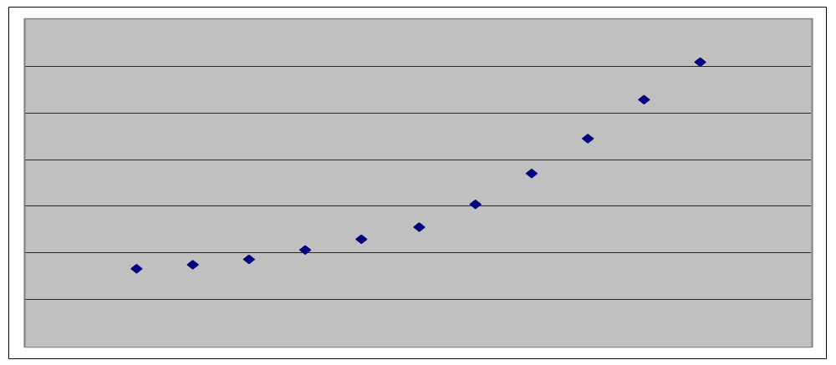
Its scatter graph can be fitted by an exponential curve using exponential regression
P(t) ≈ f(t) = 0.008196783 ⋅ (1.013723)^{t}

Slide 17
Example: half-life of strontium-90 is 25years
(a) m(0) = 24. Find the mass m(t) after t years
Solution : (a)
It appears that

Slide 18
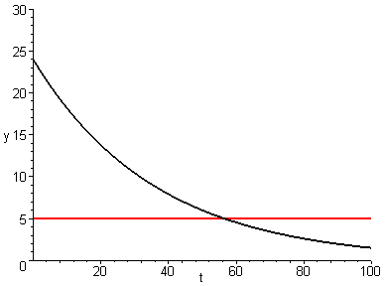
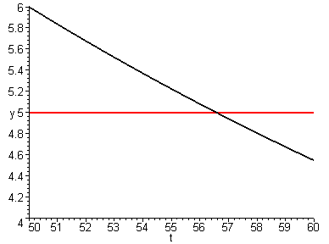
(b) The mass remains after 40 years:
(c)
(c) The mass will be reduced to 5mg after 57 years:

Slide 19
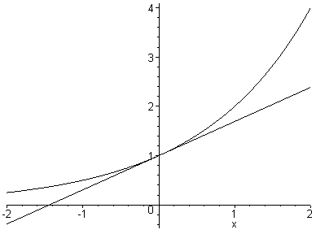
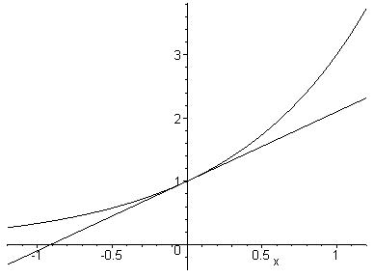
1.5.3 The number e
2^{x}
3^{x}
m≈0.69
m≈1.1
The number e is defined by the fact that the slope of the tangent of the graph of e^{x} at the point (0,1) is 1

Slide 20
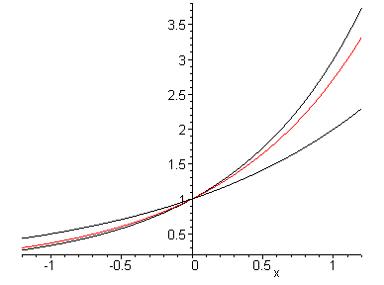
e ≈ 2.71828
y=3^{x}
y=e^{x}
y=2^{x}

Slide 21
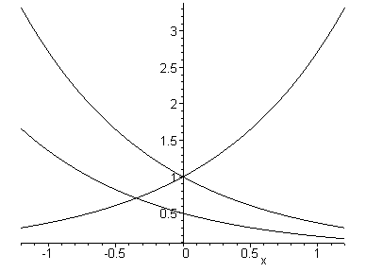
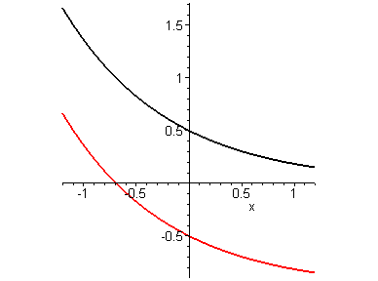

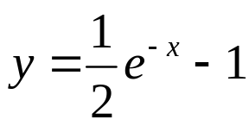
Example: graph the function
y=e^{–x}
y=e^{x}
To plot the graph we first reflect the graph of y = e^{x} about the y-axis, then compress vertically by 2. Finally we shift downward by 1

Slide 22
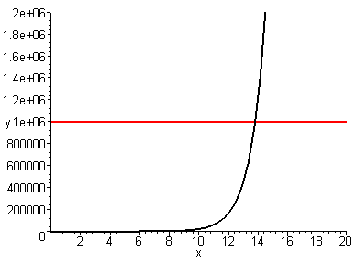
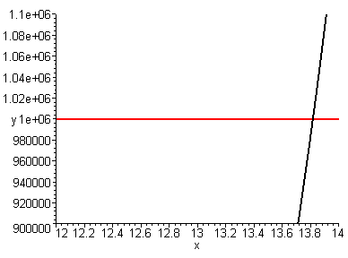
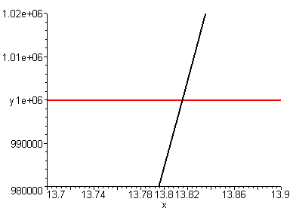
Example: find the values of x such that e^{x} > 1,000,000
Solution: x > 13.8

